Slide 1
Chapter 18 – Smoothing Methods
Data Mining for Business Analytics in R
Shmueli, Bruce, Yahav, Patel & Lichtendahl

Slide 2
Smoothing is “data driven”
Regression methods assume underlying unchanging structure (linear, exponential, polynomial)
Smoothing derives forecasts based directly on the data alone (e.g. averaging), with no mathematical structural assumptions
Suitable where the components (trend, seasonality) change over time

Slide 3
Simple moving average (MA)
Set window width “w” – take average of the w values.
For centered moving average, window is centered around forecast point
For w=5, the forecast for t₃ averages the values t₁ … t₅
Not useful for future forecasts
For future forecasts, use “trailing average” = the value being forecast is at the end of the window

Slide 4
Choosing window width
Goal is to suppress seasonality and noise
Typically choose window width = season length
In Excel:
Add Trendline > Moving Average

Slide 5
Moving Average Functions
library(zoo)
# centered moving average with window order = 12
ma.centered <- ma(ridership.ts, order = 12)
# trailing moving average with window k = 12
# in rollmean(), use argument align = right to calculate a
# trailing moving average.
ma.trailing <- rollmean(ridership.ts, k = 12, align = "right")

Slide 6
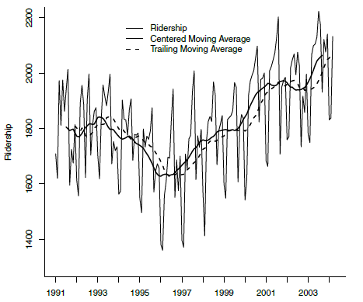
Amtrak Ridership: Moving Average Smoothing
Window W = 12

Slide 7
Plotting Code
# generate a plot
plot(ridership.ts, ylim = c(1300, 2200), ylab =
"Ridership",
xlab = "Time", bty = "l", xaxt = "n",
xlim = c(1991,2004.25), main = "")
axis(1, at = seq(1991, 2004.25, 1), labels = format(seq(1991, 2004.25, 1)))
lines(ma.centered, lwd = 2)
lines(ma.trailing, lwd = 2, lty = 2)
legend(1994,2200, c("Ridership","Centered Moving
Average", "Trailing Moving Average"),
lty=c(1,1,2), lwd=c(1,2,2), bty = "n")

Slide 8
MA forecast, and checking it in the validation period:
# partition the data
nValid <- 36
nTrain <- length(ridership.ts) - nValid
train.ts <- window(ridership.ts, start = c(1991, 1), end =
c(1991, nTrain))
valid.ts <- window(ridership.ts, start = c(1991, nTrain + 1),
end = c(1991, nTrain + nValid))
# moving average on training
ma.trailing <- rollmean(train.ts, k = 12, align = "right")
# obtain the last moving average in the training period
last.ma <- tail(ma.trailing, 1)
# create forecast based on last MA
ma.trailing.pred <- ts(rep(last.ma, nValid), start = c(1991,
nTrain + 1), end = c(1991, nTrain + nValid), freq = 12)

Slide 9
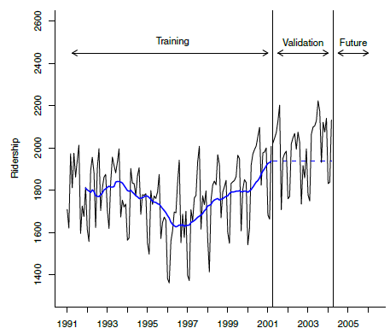
Validation forecast is the last moving average from training period

Slide 10
Moving Average for Forecasting
Shortcomings
Suppresses seasonality, but does not forecast seasonal component
Lags behind trends
Thus, simple Moving Average useful only for series that lack trend and seasonality

Slide 11
Coping with these shortcomings
Use regression model to de-trend and de-seasonalize
Use Moving Average to forecast the de-trended and de-seasonalized series
Add trend and seasonality back to the forecast

Slide 12
Simple exponential smoothing
Like MA, except use weighted average of all past values, instead of simple average in a window
Forecast at time t+1:
F_{t+1}= αY_{t} + α(1- α)Y_{t-1} + α(1- α)²Y_{t-2} + …
Equivalent to
F_{t+1}= F_{t} + αE_{t}
_{E is forecast error at time t}

Slide 13
Smoothing parameter α
Simple exponential smoother corrects based on error
If last period forecast was too high, next period is adjusted down
If last period forecast was too low, next period is adjusted up
Amount of correction depends on value of α
Value close to 1 > fast learning, close to 0 > low learning

Slide 14
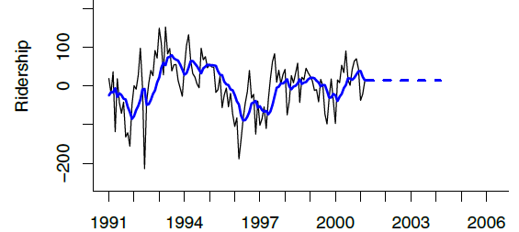
Output for simple exponential smoothing applied to residuals from regression model:
# get residuals
residuals.ts <- train.lm.trend.season$residuals
# run simple exponential smoothing
# use ets() with model = "ANN" (additive error (A),
# no trend (N), no seasonality (N))
# and alpha = 0.2 to fit simple exponential smoothing.
ses <- ets(residuals.ts, model = "ANN", alpha = 0.2)
ses.pred <- forecast(ses, h = nValid, level = 0)
y-axis is residual from regression model

Slide 15
Moving average and simple exponential smoothing can be used only when there is no trend or seasonality. When those features are present:
One solution is to remove those components via regression
Another is to use advanced exponential smoothing, which can capture trend and seasonality
Double-exponential smoothing used for series with a trend

Slide 16
Double exponential smoothing
Incorporates trend
K-step ahead forecast is derived from the level (L) and trend (T) estimates at time t
F_{t+k} = L_{t} + kT_{t}
where
L_{t} = αY_{t} + (1-α)(L_{t-1} + T_{t-1})
T_{t}= β(L_{t} – L_{t-1}) + (1- β)T_{t-1}

Slide 17
Holt Winters exponential smoothing
Extension of double exponential smoothing
Incorporate both trend and seasonality

Slide 18
Holt Winters forecast for time t+k
Adds seasonality to double exponential
For M seasons (e.g. M=7 for weekly), forecast is
F_{t+k} = (L_{t} + kT_{t})S_{t+k-M}
Where L = level, T = trend, S = season

Slide 19
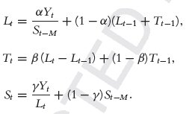
Updating L, T and S
Like eq. for double exponential, except for seasonal adjustment term
Like double exponential equation
Equation to update seasonal index

Slide 20
Holt Winters predictions:
# run Holt-Winters exponential smoothing
# use ets() with option model = "MAA" to fit Holt-
# Winter's exponential smoothing
# with multiplicative error, additive trend, and
# additive seasonality.
hwin <- ets(train.ts, model = "MAA")
# create predictions
hwin.pred <- forecast(hwin, h = nValid, level = 0)

Slide 21
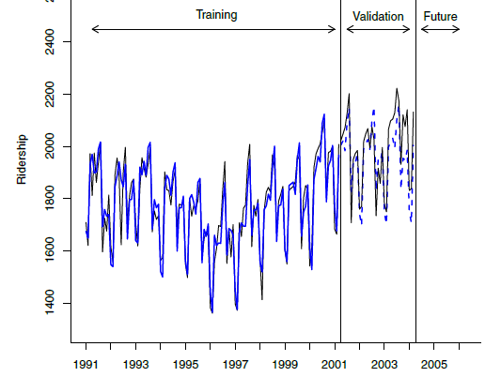
Holt-Winters Predictions

Slide 22
Summary
Smoothing methods rely on local data, not mathematical structure
Simple smoothing does not account for trend and seasonality, but can be combined with model-based forecasts to improve the forecast
Holt-Winters smoothing incorporates seasonality and trend

